Slide 1





“SMOKE PULSE”
PRESENTATION
Smoke Pulse predicts the likelihood of a fire alarm being triggered based on smoke detection, enhancing public safety, reducing false alarms, and improving early warning systems.
Richardson, Texas 75080

Slide 2
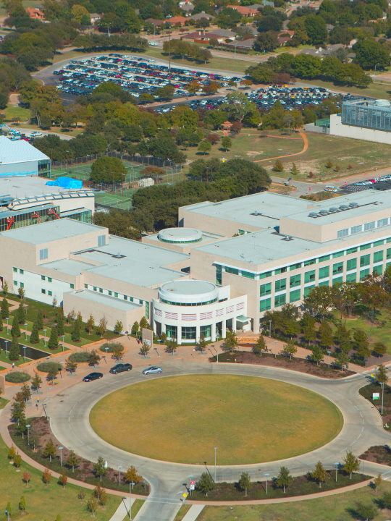
PROBLEM STATEMENT
Growing fire risks in residential and industrial areas.
Ensuring safety through early smoke detection.
Inefficiencies in identifying and alerting potential fire hazards in real-time

Slide 3
OBJECTIVES
Analyze fire alarm system data.
Develop fire detection model using decision trees and logistic regression.
Evaluate model performance and implement for fire safety.
Develop an interactive user interface using R Shiny package and CSS.

Slide 4
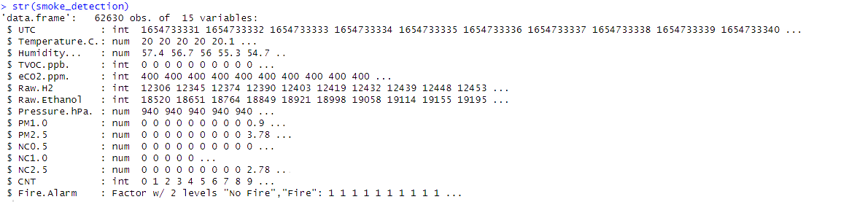
DATA EXPLORATION & VISUALIZATION DATASET STRUCTURE
Total 62630 observations.
15 variables in the dataset ‘smoke_detection’.
The last variable, Fire.Alarm, is categoric (called “factor” in R) and has 2 levels of values.

Slide 5
DATA VISUALIZATION AND EXPLORATION
15 variables in the dataset ‘smoke_detection’ are : -
UTC: Timestamp of the recorded data in Coordinated Universal Time. (IV)
Temperature [C]: Ambient temperature measured in degrees Celsius. (IV)
Humidity [%]: Relative humidity as a percentage. (IV)
TVOC [ppb]: Total Volatile Organic Compounds measured in parts per billion. (IV)
eCO2 [ppm]: Equivalent CO2 levels measured in parts per million. (IV)
Raw H2: Raw measurement of hydrogen gas concentration. (IV)
Raw Ethanol: Raw measurement of ethanol gas concentration. (IV)
Pressure [hPa]: Atmospheric pressure measured in hectopascals. (IV)
PM1.0: Concentration of particulate matter smaller than 1.0 micrometers. (IV)
PM2.5: Concentration of particulate matter smaller than 2.5 micrometers. (IV)
NC0.5: Number concentration of particles smaller than 0.5 micrometers. (IV)
NC1.0: Number concentration of particles smaller than 1.0 micrometers. (IV)
NC2.5: Number concentration of particles smaller than 2.5 micrometers. (IV)
CNT: Count of data points recorded sequentially. (IV)
Fire Alarm: Indicator if a fire alarm was triggered (1 for triggered, 0 for not). (DV)

Slide 6
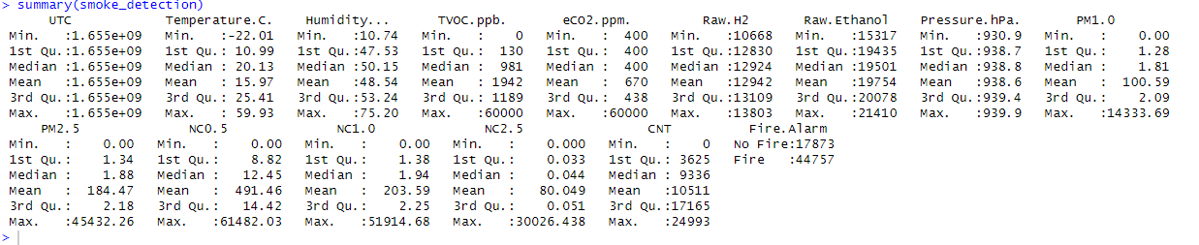
DATA VISUALIZATION AND EXPLORATION

Slide 7
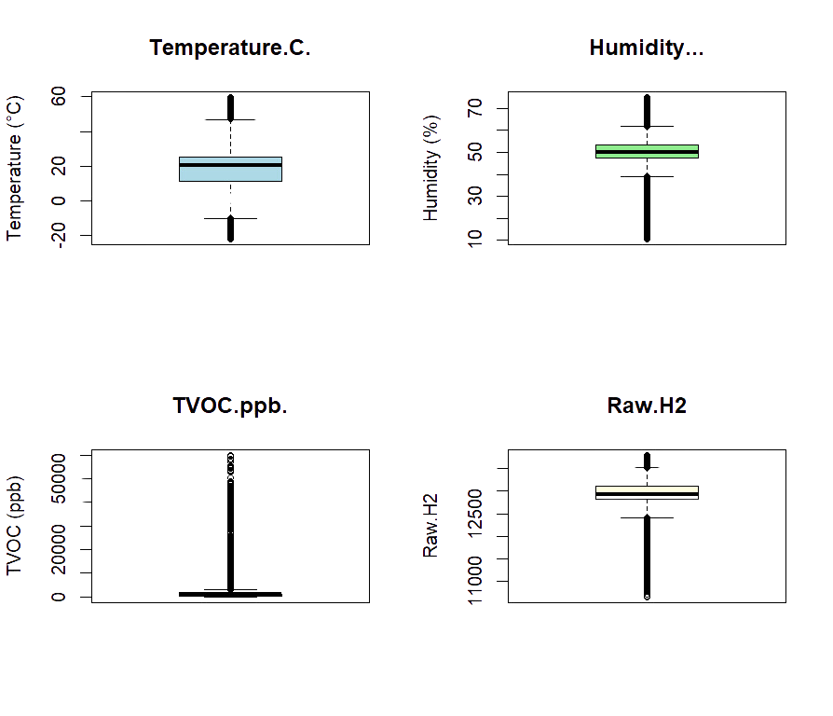
DATA VISUALIZATION AND EXPLORATION
Box plots before removing outliers.
Number of observations before removing Outliers are 62630.

Slide 8
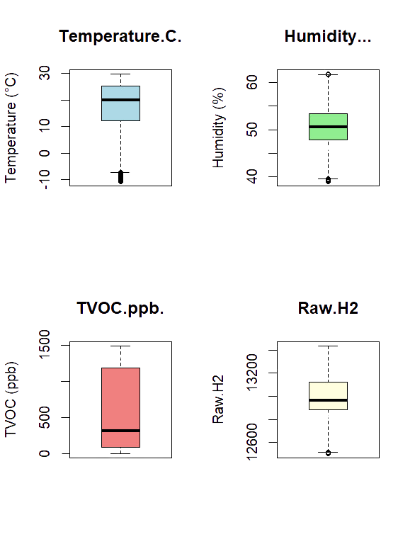
DATA VISUALIZATION AND EXPLORATION
Box plots after removing outliers.
Number of observations after removing Outliers are 43463.

Slide 9
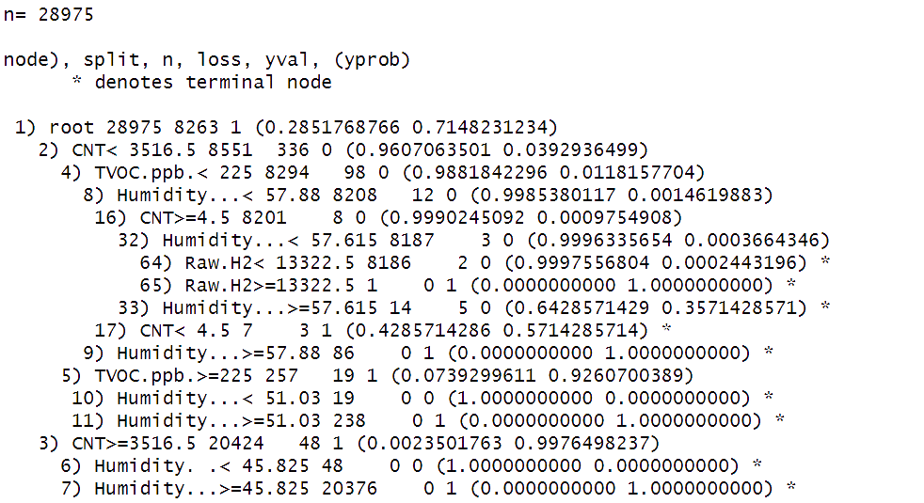
DECISION TREE CLASSIFIER
We have trained the model based on the following split - 67% Train and 33% Test.
Observations for Training 28975
Observations for Testing 14488

Slide 10
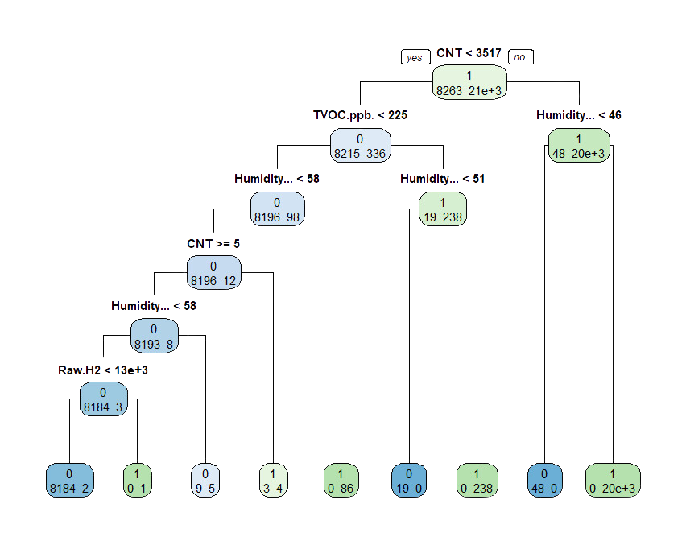
DECISION TREE

Slide 11
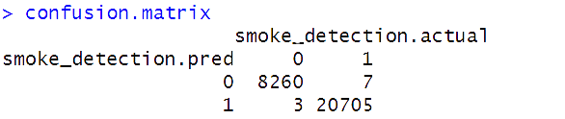
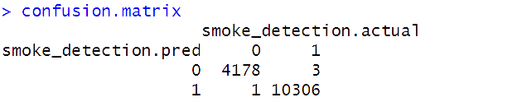
DECISION TREE CLASSIFIER
Confusion Matrix of Train Dataset:-
Performance of Train Dataset:
Accuracy : 0.9996549
Error rate : 0.0003451251
TPR : 0.999662
TNR : 0.9996369
FPR : 0.0003630643
FNR : 0.0003379683
Confusion Matrix of Test Dataset:-
Performance of Test Dataset:-
Accuracy : 0.9997239
Error rate : 0.0002761
TPR : 0.999709
TNR : 0.9997607
FPR : 0.0002392917
FNR : 0.0002910079

Slide 12
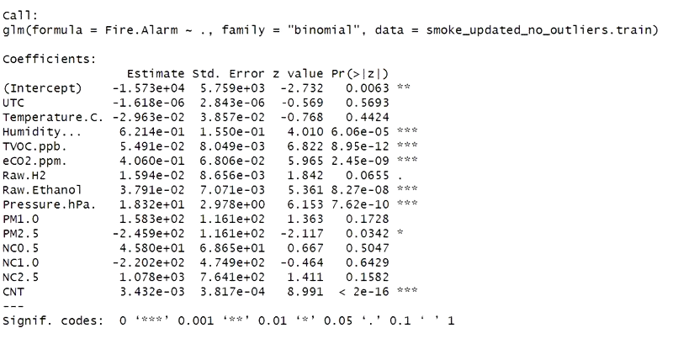
LOGISTIC REGRESSION
Summary of logistic regression screenshot.

Slide 13
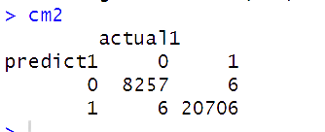
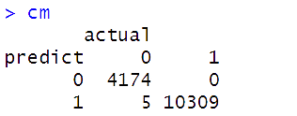
LOGISTIC REGRESSION - PERFORMANCE
Confusion Matrix of Train Dataset:-
Performance of Train Dataset:-
Accuracy : 0.9995858
Error rate : 0.0004142
TPR : 0.9997103
TNR : 0.9992739
FPR : 0.0007261285
FNR : 0.0002896871
Confusion Matrix of Test Dataset:-
Performance of Test Dataset:-
Accuracy : 0.9996549
Error rate : 0.0003451
TPR : 1
TNR : 0.9988035
FPR : 0.001196458
FNR : 0

Slide 14
INTERPRETATIONS
Interpretation for Humidity: An increase of 1 percent in humidity corresponds to an 86.15% increase in the odds of triggering the fire alarm.
Effect of TVOC (ppb): A rise of 1 unit in TVOC concentration (measured in parts per billion) is associated with a 5.65% increase in the odds of activating the fire alarm.
Change in Raw H2: An increase of 1 unit of Raw H2 results in a multiplication of the odds of triggering the fire alarm by a factor of 1.0161.
Raw Ethanol: An increase of 1 unit of Raw Ethanol multiplies the odds of activating the fire alarm by a factor of 1.0386.
Interpretation for CNT: An increase of 1 unit of CNT multiplies the odds of triggering the alarm by 1.0034.

Slide 15
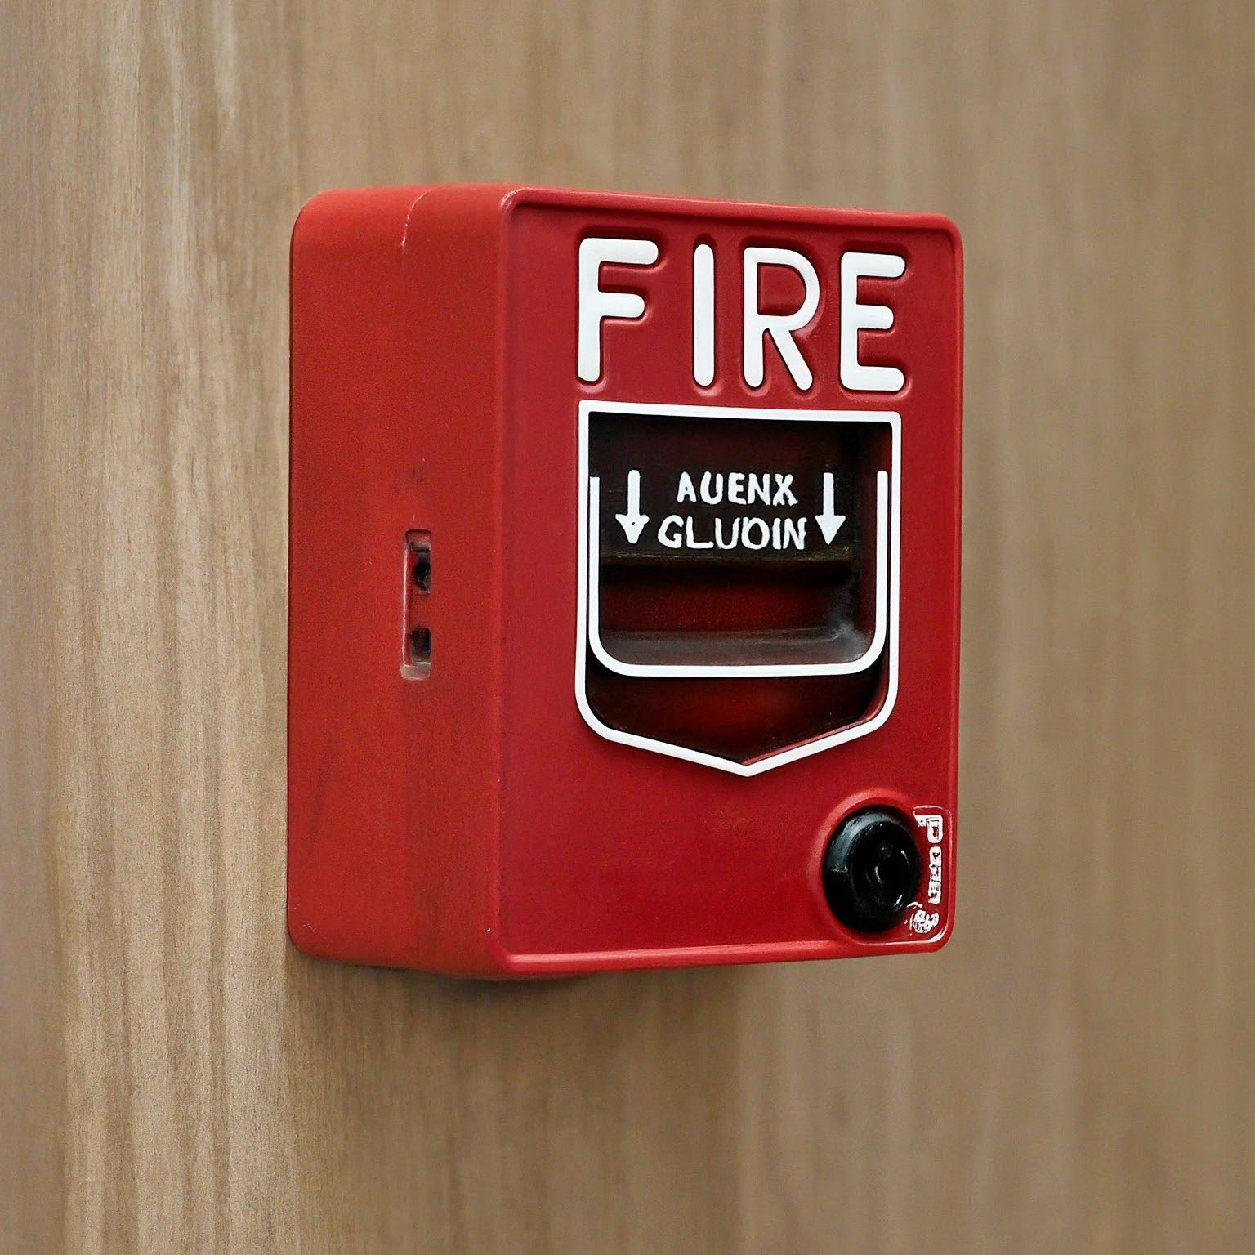
Thank You
FOR YOUR ATTENTION
Richardson, Texas 75080

